Slide 1
Introducing Packages
Packages are containers for classes that are used to keep the class name space compartmentalized. For example, a package allows you to create a class named List, which you can store in your own package without concern that it will collide with some other class named List stored elsewhere.
Packages are stored in a hierarchical manner and are explicitly imported into new class definitions.
Java provides a mechanism for partitioning the class name space into more manageable chunks. This mechanism is the package.
The package is both a naming and a visibility control mechanism.
You can define classes inside a package that are not accessible by code outside that package ( ).

Slide 2
Introducing Packages
Preventing naming conflicts. For example there can be two classes with name Employee in two packages, college.staff.cse.Employee and college.staff.ee.Employee (naming mechanism).
Making searching/locating and usage of classes, interfaces easier.
Providing controlled access: protected and default have package level access control. A protected member is accessible by classes in the same package and its subclasses. A default member (without any access specifier) is accessible by classes in the same package only.
Packages can be considered as data encapsulation (or data-hiding). By grouping related classes and interfaces together and controlling access using access modifiers. They hide internal classes and members from other packages, exposing only necessary public members.

Slide 3
Defining Packages
Include a package command as the first statement in a Java source file.
Any classes declared within that file will belong to the specified package.
The package statement defines a name space in which classes are stored.
If you omit the package statement, the class names are put into the default package, which has no name.
Syntax: package pkg;
Here, pkg is the name of the package.
For example: package MyPackage;
Java uses file system directories to store packages. For example, .class files for any classes you declare to be part of MyPackage must be stored in a directory called MyPackage.
More than one file can include the same package statement.

Slide 4
Defining Sub - Packages
File Directory –
It is the physical folder on your system where the project files are saved.
A Java Project is comprised of libraries, src folder (source folder containing .java files) & bin folder (stores all compiled .class files).
You can create a hierarchy of packages. To do so, simply separate each package name from the one above it by use of a period.
Syntax:
package pkg1[.pkg2[.pkg3]];
package java.awt.image;
needs to be stored in java\awt\image in a Windows environment.

Slide 5
Defining Sub - Packages
You can create a hierarchy of packages. To do so, simply separate each package name from the one above it by use of a period.
Syntax:
package pkg1[.pkg2[.pkg3]];
package java.awt.image;
needs to be stored in java\awt\image in a Windows environment.
File directory is defined as the physical folder on your computer where the project files are saved
Java Project
Libraries
Bin folder – stores .class files after compilation of java code
src (source folder) – write and save .java files

Slide 6
Classpath of Packages
Class Path is defined list of locations or folders where JVM looks for compiled classes i.e. looks for .class files while running a program.
Scenario – My Java program may use multiple classes spread across packages.
OR
We are using class from another package in our program, where will
JVM search for .class file now ??????
When we use user-defined packages, our classes are often in different folders (like Package1, Package2, Package3 etc.), So we need to tell Java where to find them – That’s done using CLASSPATH.

Slide 7
Classpath of Packages
How does the Java run-time system know where to look for packages that you create?
First, by default, the Java run-time system uses the current working directory as its starting point. Thus, if your package is in a subdirectory of the current directory, it will be found. JVM uses current working directory as its starting point (it will start searching in current .class file’s bin folder)
Second (PERMANENTLY), you can specify a directory path or paths by setting the CLASSPATH environmental variable. Setting classpath environment variables. Steps (Windows)-Environment variables-system variables-click new- set name for classpath – set value for classpath
Third (TEMPORARY), you can use the –classpath option with java and javac to specify the path to your classes.

Slide 8
Importing Packages
To use classes from other packages- Java programs are organized into packages that contain related classes. If you want to use a class from another package, you must import it.
To reuse predefined classes and methods – Java provides thousands of build-in classes (eg. String, Arraylist, Scanner, Math, File) organized in packages.
To organize and modularize large projects – In large projects code is divide into many packages, importing helps to connect these modules together.
Java includes import statement to bring certain classes or entire packages, into visibility.
The import statement is a convenience to programmer and is not technically needed to write a complete Java program.
In a Java source file, import statements occur immediately following package statement (if it exists) and before any class definitions.

Slide 9
Importing Packages
Importing Packages in Java :
Single / Particular Class
(using period classname
with period .)
All Classes of the packages
(using * with period .)
Syntax :- import packages_name.*;
import package_name.class_name;
Specify either an explicit classname or a star (*), which indicates that Java compiler should import entire package.
Examples :- import java.util.Date;
import java.io.*;

Slide 10
Example Importing Packages - builtin.java

Slide 11
Package Access Protection
Packages act as containers for classes and other subordinate packages.
Java addresses four categories of visibility for class members
Public – Accessible from anywhere, regardless of whether class is in same package or not.
Default – Members with no modifiers are accessible only within same package.
Protected – Accessible outside the package but only to the direct subclasses (subclasses that are directly inherited from the your class with no chains).
Private – Accessible only within same package. They cannot be accessed by classes in same package, subclass or different package.

Slide 12
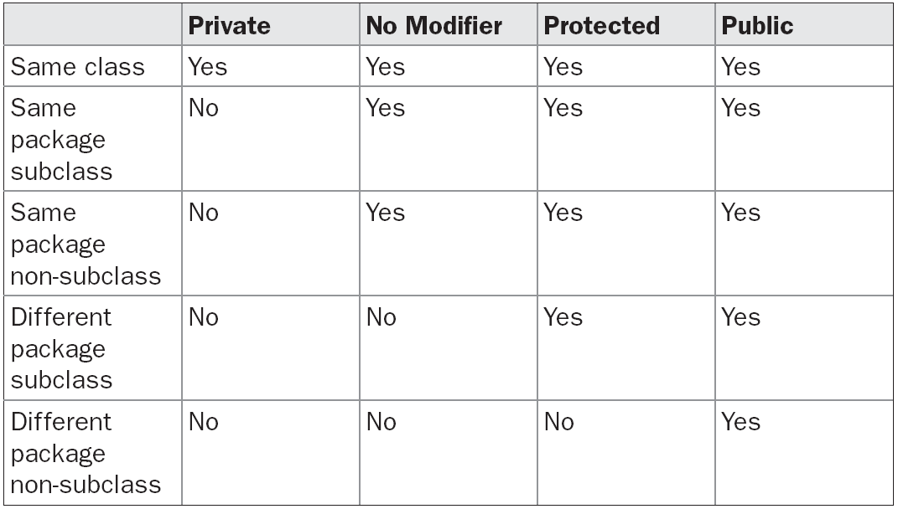
Package Access Protection

Slide 13
Example Package Access Protection – hello1.java, hello3.java, hello2.java

Slide 14
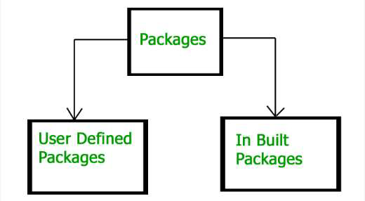
Types Of Packages
Two types
1. Built-in Packages
java.lang: Contains language support classes
java.io: Contains classed for supporting input / output operations.
java.applet: Contains classes for creating Applets.
2. User-defined packages
These are the packages that are defined by the user.

Slide 15
Types Of Packages
Example of Built-in Packages :hello1.java, hello2.java
Example of User-defined packages : builtin.java

Slide 16
Defining Interfaces
Interfaces are syntactically similar to classes, but they lack instance variables, also methods are abstract.
A class can implement an interface, to do so, a class will have to define complete set of methods required by interface.
These are Runtime Polymorphism.
DEFINING AN INTERFACE :
Syntax :-
access interface_name{
returntype method_name (parameter-list);
type variable_name = value;
}

Slide 17
Defining Interfaces
If no access defined to interface, then default will apply (default means available within package declared).
If its public – anywhere access.
Variables can be declared as Final, Static and Public .
Variables must be initialized when declared within interface, otherwise will give error.
Methods have no body when defined in interfaces (abstract in nature).
Returntype – void, int , double etc.
Class implementing an interface must define all methods of that interface.

Slide 18
Implementing Interfaces
Syntax –
Class class_name implements interface_name{
//class body
}
The keyword implements is used to implement an interface through a class.
Class implementing an interface must define all methods of that interface.
A class can implement more than one interface at a tie seprated by commas.
Syntax –
Class class_name implements interface_name1, interface_name2, interface_name3{
//class body
}

Slide 19
Accessing Methods of Interfaces
When a class implements an inteface, it provides the definitions (bodies) for all the abstract methods declared in that interface.
To access (or call) those interface methods, we use an object of the implementing class.
To access methods of interface implemented through class, we need to create objects of class implementing it.
Method call resolved at runtime based on actual object type – demonstrates runtime polymorphism.

Slide 20
Nested Interface
A nested Interface is an Interface declared inside a class or another interface.
When declared inside a class
it can have any access modifiers – public, protected, default and private.
Qualify with outerclassname as :-
outerclassname.interfacename;
When declared inside another interface
Inner Interface can be public or static.
Outer Interface must be public or default.
Qualify it with outerinterfacename as:-
outerinterfacename.innerinterfacename;
N1.java N2.java

Slide 21
Extended Interfaces
By using extends keyword
But a class is needed to implement methods of chain of interface
Just like classes in java, we can extend interfaces also with use of the keyword “extends”.
One interface can extend another interface just as classes in inheritance.
If interface B is extending interface A, it will get the properties of interface A.

Slide 22
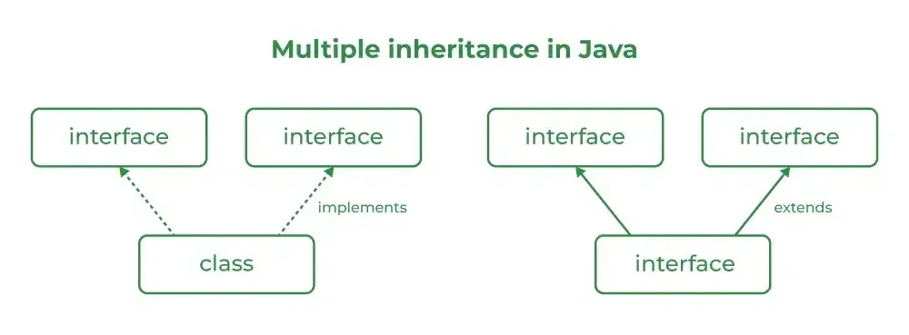
Multiple Inheritance through Interfaces
Java does not support multiple inheritance with classes to avoid ambiguity, but it supports multiple inheritance using interfaces
Step 1: Define the interfaces
Step 2: Implement the interfaces in the class
Step 3: Create an object of the class and call the interface methods

Slide 23
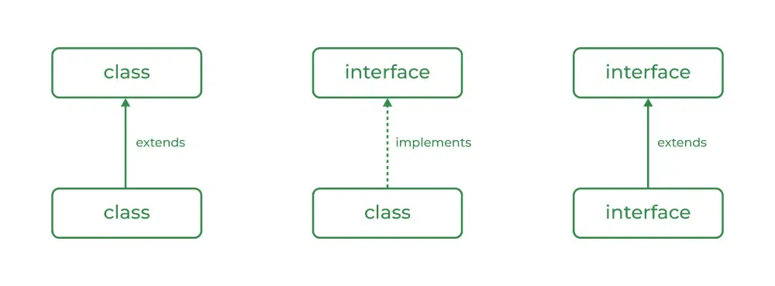
Relationship between Class & Interfaces
A class can extend another class and similarly, an interface can extend another interface.
However, only a class can implement an interface and the reverse (an interface implementing a class) is not allowed.

Slide 24
When to Use Class and Interface?
Use a Class when:
Use a class when you need to represent a real-world entity with attributes (fields) and behaviors (methods).
Use a class when you need to create objects that hold state and perform actions
Classes are used for defining templates for objects with specific functionality and properties.
Use a Interface when:
Use an interface when you need to define a contract for behavior that multiple classes can implement.
Interface is ideal for achieving abstraction and multiple inheritance.

Slide 25
Difference between Class & Interfaces
Instantiation | In class, you can create an object with or without initialization. | In an interface, you can't create an object without initialization.
Variables | Class can have instance variables | Variables are public (anywhere access) static (belongs to class, not any specific object, access without creating object) final (constants only).
Methods | Class can have concrete methods (with implementation details) | In an interface, methods are abstract by default (no implementation details)
Access Modifiers | Supports private, protected, public, default. | In an interface, all members are public or default (no modifier).
Default Methods | It does not support default methods | It supports default methods(JDK 8+)

Slide 26
Default Methods / Extension Methods
Default Methods in Java, introduced in Java 8, are methods defined within an interface that include an implementation body.
They are declared using the default keyword.
Example :-
interface Vehicle{
default void start() {
System.out.println("Vehicle is Starting");} //DEFAULT METHOD
void drive(); } // ABSTRACT METHOD

